Slide 1

Generic Code Optimization
Jack Dongarra, Shirley Moore,
Keith Seymour, and Haihang You
LACSI Symposium
Automatic Tuning of Whole Applications Workshop
October 11, 2005

Slide 2

Generic Code Optimization
Take generic code segments and perform optimizations via experiments (similar to ATLAS)
Collaboration with ROSE project (source-to-source code transformation / optimization) at Lawrence Livermore National Laboratory
  Daniel Quinlan and Qing Yi
Notes:
We are trying to extend the idea of ATLAS, which performs empirical optimization for algorithms that are known ahead of time, to include optimization of arbitrary code segments. Among other things, the ROSE project from Lawrence Livermore National Lab provides a source-to-source code transformation tool that can produce blocked and unrolled versions of the input code (currently supporting only C). We have developed a test infrastructure that automatically generates a timing driver for the optimized routine based on a simple description of the arguments.

Slide 3
GCO
A source-to-source transformation approach to optimize arbitrary code, especially loop nests in the code.
    Machine parameters detection
    Source to source code generation
    Testing driver generation
    Empirical search engine

Slide 4
GCO Framework
code
Driver
generator
testing
driver
₊
front end
IR
Loop Analyzer
CG
code
tuning parameters
Search Engine
info of tuning parameters

Slide 5
Simplex Method
Simplex method is a non-derivative direct search method for optimal value
N+1 points of N dimension search space make up a simplex
Basic Operations: reflection, expansion, contraction, and shrink.

Slide 6
Basic Simplex
X₂
X₂
X₂
X_{r}
X_{r}
X₁
X₁
X_{c}
X₃
X₃
X₃
Basic idea of Simplex Method in 2D:
To find maximum value of f(x) in a 2-dim search space
The simplex consists X₁, X₂, X₃. suppose f(X₁) <= f(X₂)<=f(X₃)
In each step, we can find X_{c} which is the centroid of X₂ and X₃, replace X₁ with X_{r} which is the reflection of X₁ through X_{c}.
Notes:
This describes the basic operation of the simplex method and how the points are selected.

Slide 7
DGEMM ATLAS Search Space
8 dimensional space for search
ATLAS does orthogonal searching
Represents 1 M search points!!
NB: Cache Blocking LAT: FP unit latency
MU NU: Register Blocking KU: unrolling
FFTCH: determine prefetch of matrix C into registers
IFTCH NFTCH: determine the interleaving of loads with computation
simplex32 LAT NB MU NU KU FFTCH IFTCH NFTCH
upper bound 16 32 16 16 32 1 16 16
lower bound 1 16 1 1 1 0 2 1
Notes:
In the previous slides we were dealing with only two parameters, but now we consider the search space for ATLAS, which contains 8 dimensions. ATLAS performs an orthogonal search (optimizing one dimension at a time), but we are interested in applying the simplex method to this search problem. To keep the search time reasonable, we define constraints for each parameter. Note that we are still using the ATLAS code generator -- we have only replaced the search component of the system.

Slide 8
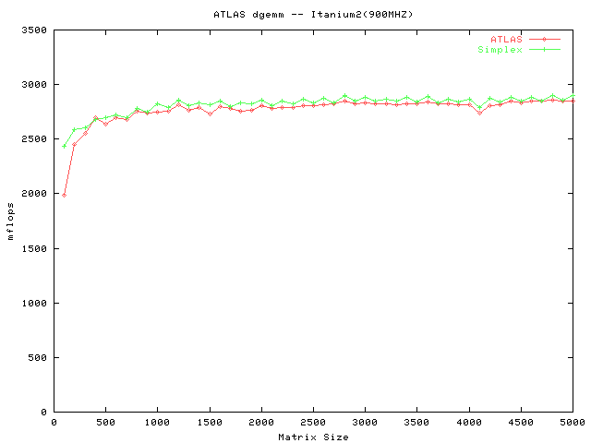
Comparison of performance of DGEMM generated with ATLAS and Simplex search
Notes:
This graph compares the performance of the code generated by ATLAS versus the code generated using the simplex method. “ATLAS cgws” (cgws == code generator with search) represents the original ATLAS search method. We show two simplex variations here. One has the block size bounded at 64 and the other at 32. The larger block size performs better, but requires a longer search time, even compared to the original ATLAS search. “mdel” is a model-based technique developed at Cornell.

Slide 9
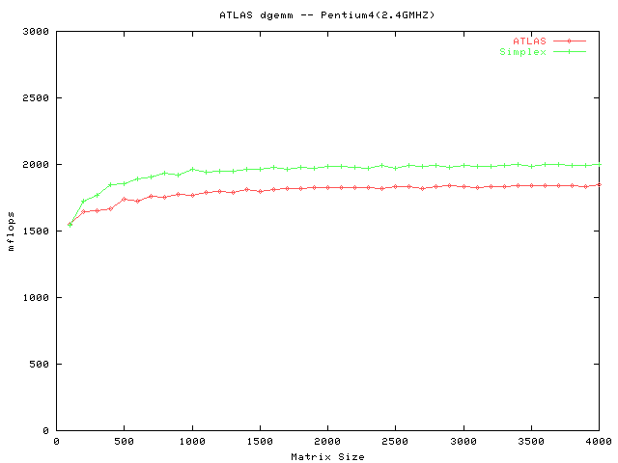
Comparison of performance of DGEMM generated with ATLAS and Simplex search
Notes:
This graph compares the performance of the code generated by ATLAS versus the code generated using the simplex method. “ATLAS cgws” (cgws == code generator with search) represents the original ATLAS search method. We show two simplex variations here. One has the block size bounded at 64 and the other at 32. The larger block size performs better, but requires a longer search time, even compared to the original ATLAS search. “mdel” is a model-based technique developed at Cornell.

Slide 10
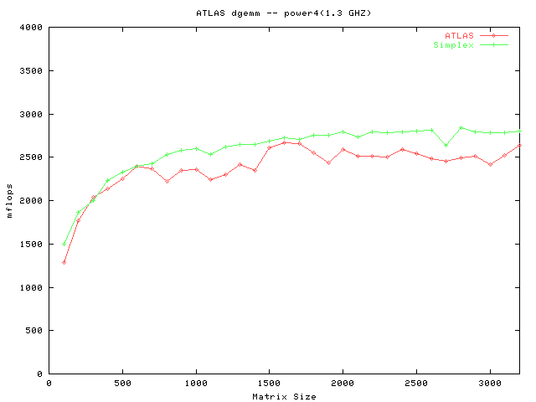
Comparison of performance of DGEMM generated with ATLAS and Simplex search
Notes:
This graph compares the performance of the code generated by ATLAS versus the code generated using the simplex method. “ATLAS cgws” (cgws == code generator with search) represents the original ATLAS search method. We show two simplex variations here. One has the block size bounded at 64 and the other at 32. The larger block size performs better, but requires a longer search time, even compared to the original ATLAS search. “mdel” is a model-based technique developed at Cornell.

Slide 11
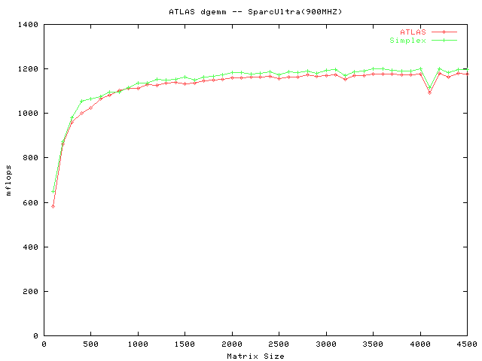
Comparison of performance of DGEMM generated with ATLAS and Simplex search
Notes:
This graph compares the performance of the code generated by ATLAS versus the code generated using the simplex method. “ATLAS cgws” (cgws == code generator with search) represents the original ATLAS search method. We show two simplex variations here. One has the block size bounded at 64 and the other at 32. The larger block size performs better, but requires a longer search time, even compared to the original ATLAS search. “mdel” is a model-based technique developed at Cornell.

Slide 12
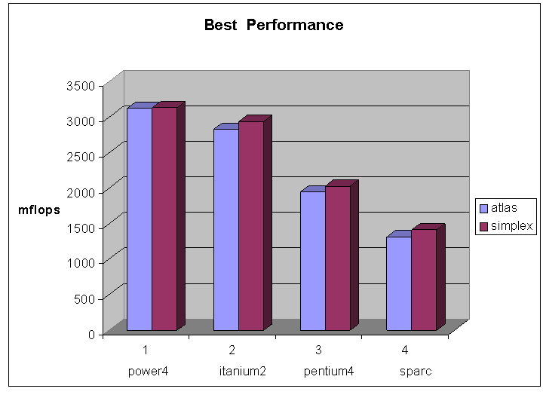
Comparison of performance of DGEMM on1000x1000 matrix generated with ATLAS and Simplex search
Notes:
This graph compares the performance of the code generated by ATLAS versus the code generated using the simplex method. “ATLAS cgws” (cgws == code generator with search) represents the original ATLAS search method. We show two simplex variations here. One has the block size bounded at 64 and the other at 32. The larger block size performs better, but requires a longer search time, even compared to the original ATLAS search. “mdel” is a model-based technique developed at Cornell.

Slide 13
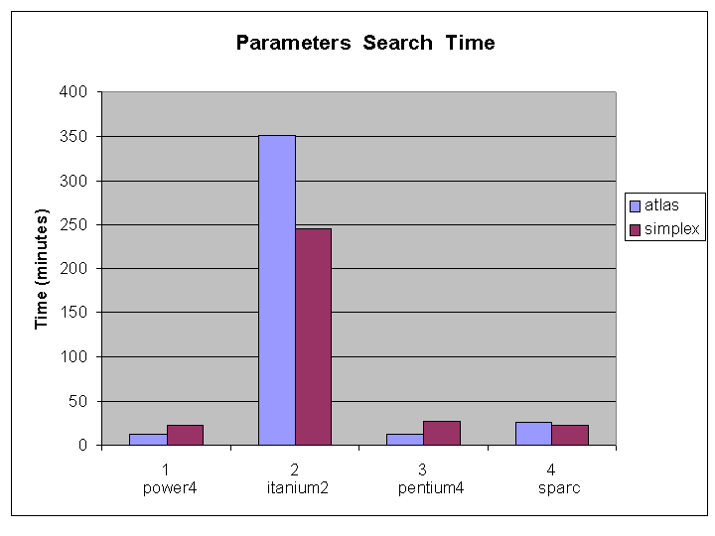
Comparison of parameters’ search time ATLAS and Simplex search
Notes:
This graph compares the performance of the code generated by ATLAS versus the code generated using the simplex method. “ATLAS cgws” (cgws == code generator with search) represents the original ATLAS search method. We show two simplex variations here. One has the block size bounded at 64 and the other at 32. The larger block size performs better, but requires a longer search time, even compared to the original ATLAS search. “mdel” is a model-based technique developed at Cornell.

Slide 14
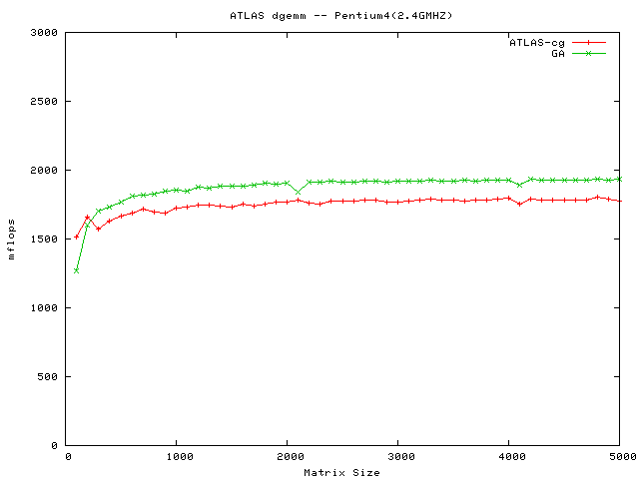
Comparison of performance of DGEMM generated with ATLAS and Parallel GA(GridSolve)
Notes:
This graph compares the performance of the code generated by ATLAS versus the code generated using the simplex method. “ATLAS cgws” (cgws == code generator with search) represents the original ATLAS search method. We show two simplex variations here. One has the block size bounded at 64 and the other at 32. The larger block size performs better, but requires a longer search time, even compared to the original ATLAS search. “mdel” is a model-based technique developed at Cornell.

Slide 15
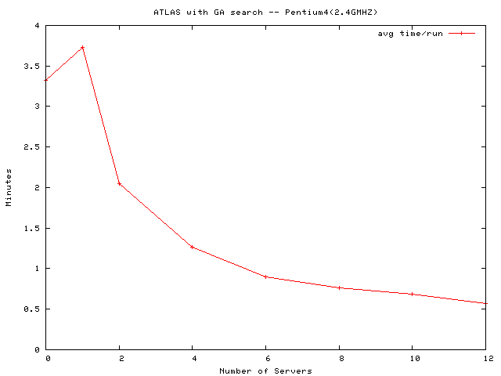
Comparison of parameters’ search time ATLAS and Parallel GA(GridSolve)
Notes:
This graph compares the performance of the code generated by ATLAS versus the code generated using the simplex method. “ATLAS cgws” (cgws == code generator with search) represents the original ATLAS search method. We show two simplex variations here. One has the block size bounded at 64 and the other at 32. The larger block size performs better, but requires a longer search time, even compared to the original ATLAS search. “mdel” is a model-based technique developed at Cornell.

Slide 16
Code Generation
Collaboration with ROSE project (source-to-source code transformation/optimization) at Lawrence Livermore National Laboratory
LoopProcessor -bk3 4 -unroll 4 ./dgemv.c

Slide 17
Testing Driver Generation
/*$ATLAS ROUTINE DGEMV */
/*$ATLAS SIZE 1000:2000:100 */
/*$ATLAS ARG M IN int $size */
/*$ATLAS ARG N IN int $size */
/*$ATLAS ARG ALPHA IN double 1.0 */
/*$ATLAS ARG A[M][N] IN double $rand */
/*$ATLAS ARG B[N] IN double $rand */
/*$ATLAS ARG C[M] INOUT double $rand */
void dgemv (int M, int N, double alpha, double* A, double * B, double* C)
{
int i, j;
/* matrices are stored in column major */
for (i = 0; i < M; ++i) {
for (j = 0; j <N ; ++j) {
C[i] += alpha * A[j*M + i] * B[j];
}
}
}
Testing driver initializes variables and collects performance data.
Wallclock time or Hardware counter data

Slide 18
int min(int ,int );
/*$ATLAS ROUTINE DGEMV */
/*$ATLAS SIZE 1000:1000:1 */
/*$ATLAS ARG M IN int $size */
/*$ATLAS ARG N IN int $size */
/*$ATLAS ARG ALPHA IN double 1.0 */
/*$ATLAS ARG A[M][N] IN double $rand */
/*$ATLAS ARG B[N] IN double $rand */
/*$ATLAS ARG C[M] INOUT double $rand */
void dgemv(int M,int N,double alpha,double * A,double * B,double * C)
{
int _var_1;
int _var_0;
int i;
int j;
for (_var_1 = 0; _var_1 <= -1 + M; _var_1 += 4) {
for (_var_0 = 0; _var_0 <= -1 + N; _var_0 += 4) {
for (i = _var_1; i <= min((-1 + M),(_var_1 + 3)); i += 1) {
for (j = _var_0; j <= min((N + -4),_var_0); j += 4) {
C[i] += (alpha * A[(j * M + i)]) * B[j];
C[i] += (alpha * A[((1 + j) * M + i)]) * B[(1 + j)];
C[i] += (alpha * A[((2 + j) * M + i)]) * B[(2 + j)];
C[i] += (alpha * A[((3 + j) * M + i)]) * B[(3 + j)];
}
for (; j <= min((-1 + N),(_var_0 + 3)); j += 1) {
C[i] += (alpha * A[(j * M + i)]) * B[j];
}
}
}
}
}
/*$ATLAS ROUTINE DGEMV */
/*$ATLAS SIZE 1000:1000:1 */
/*$ATLAS ARG M IN int $size */
/*$ATLAS ARG N IN int $size */
/*$ATLAS ARG ALPHA IN double 1.0 */
/*$ATLAS ARG A[M][N] IN double $rand */
/*$ATLAS ARG B[N] IN double $rand */
/*$ATLAS ARG C[M] INOUT double $rand */
void dgemv (int M, int N, double alpha, double* A, double * B, double* C)
{
int i, j;
/* matrices are stored in column major */
for (i = 0; i < M; ++i) {
for (j = 0; j <N ; ++j) {
C[i] += alpha * A[j*M + i] * B[j];
}
}
}

Slide 19
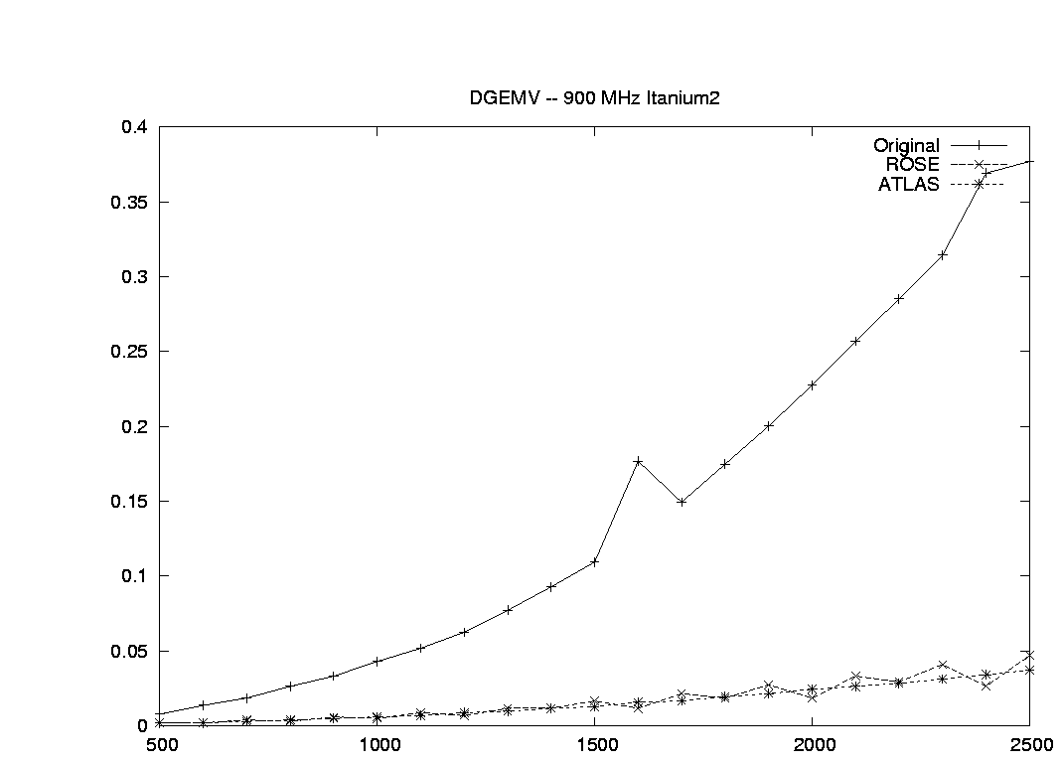
Comparison of performance of DGEMV generated with ATLAS and Simplex search with ROSE

Slide 20
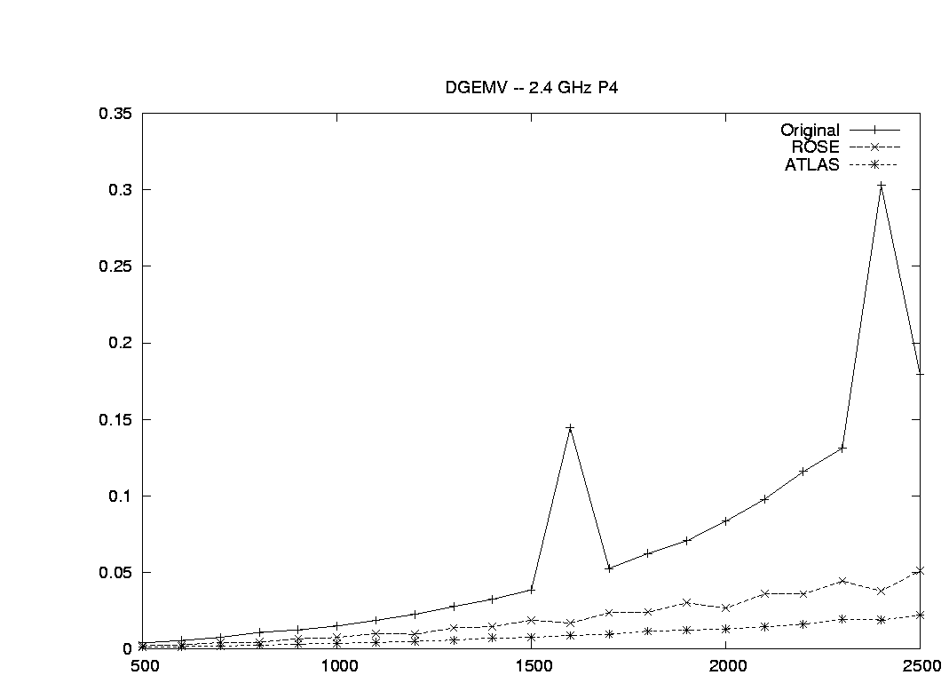
Comparison of performance of DGEMV generated with ATLAS and Simplex search with ROSE

Slide 21
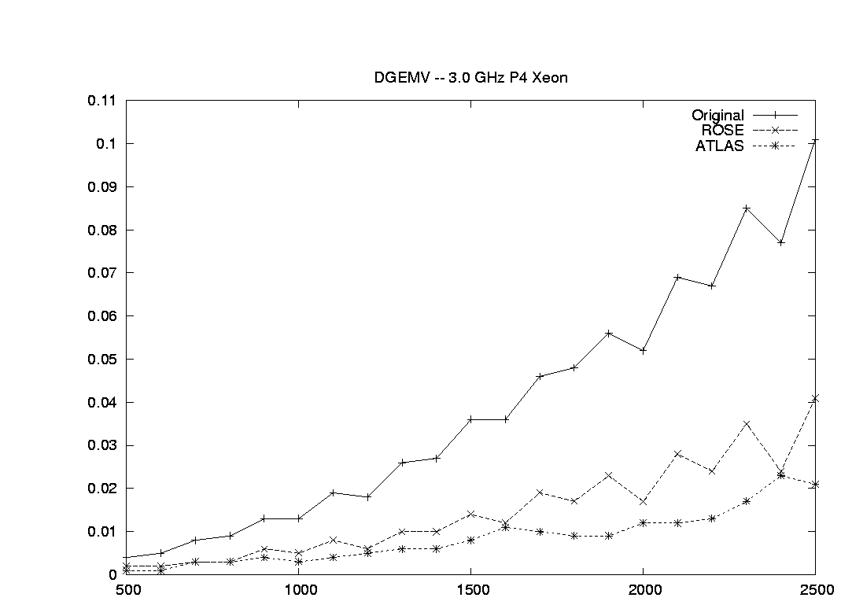
Comparison of performance of DGEMV generated with ATLAS and Simplex search with ROSE

Slide 22
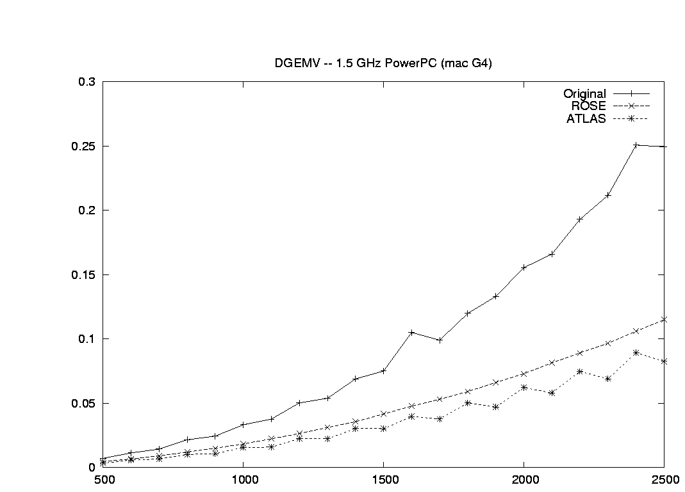
Comparison of performance of DGEMV generated with ATLAS and Simplex search with ROSE

Slide 23
cip2 = C[i + 2];
cip3 = C[i + 3];
cip4 = C[i + 4];
cip5 = C[i + 5];
cip6 = C[i + 6];
cip7 = C[i + 7];
bjp0 = B[j];
bjp1 = B[j+1];
bjp2 = B[j+2];
bjp3 = B[j+3];
bjp4 = B[j+4];
bjp5 = B[j+5];
cip0 += (A[t0]) * bjp0;
……..
C[i+6] = cip6;
C[i+7] = cip7;
}
for (; j <= rosemin(N-1,_var_0+112); j++) {
C[i] += (alpha * A[j * M + i]) * B[j];
C[i+1] += (alpha * A[j * M + i+1]) * B[j];
…….
C[i+7] += (alpha * A[j * M + i+7]) * B[j];
} }
for (; i <= rosemin((M-1),(_var_1 + 112)); i++) {
for (j = _var_0; j <= rosemin((N + -1),(_var_0 + 112)); j++) {
C[i] += (alpha * A[(j * M + i)]) * B[j];
} } } } }
void dgemv(int M,int N,double alpha,double * A,double * B,double * C)
{
int _var_1;
int _var_0;
int i;
int j;
int ub1, ub2;
for (_var_1 = 0; _var_1 <= -1 + M; _var_1 += 113) {
ub1 = rosemin((-8 + M),(_var_1 + 105));
for (_var_0 = 0; _var_0 <= -1 + N; _var_0 += 113) {
ub2 = rosemin((N + -6),(_var_0 + 107));
for (i = _var_1; i <= ub1; i += 8) {
for (j = _var_0; j <= ub2; j += 6) {
register double bjp0, bjp1, bjp2, bjp3, bjp4, bjp5;
register double cip0, cip1, cip2, cip3, cip4, cip5, cip6, cip7;
register int t0, t1, t2, t3, t4, t5;
t0 = j * M + i;
t1 = (1 + j) * M + i;
t2 = (2 + j) * M + i;
t3 = (3 + j) * M + i;
t4 = (4 + j) * M + i;
t5 = (5 + j) * M + i;
cip0 = C[i];
cip1 = C[i + 1];

